Slide 1
Modeling a NIST 800-30 Risk Register Tool
Notes:
Content Slide Notes
“UNCLASSIFIED” marking of slides is not a security requirement and may be deleted from the Slide Master (View › Master › Slide Master). In general, slides should be marked “UNCLASSIFIED” if there is potential for confusion or misinterpretation of something that could be deemed classified. For guidance on marking slides containing classified and unclassified controlled information, see the Protecting Information Web site at http://int.lanl.gov/security/protectinfo/.

Slide 2
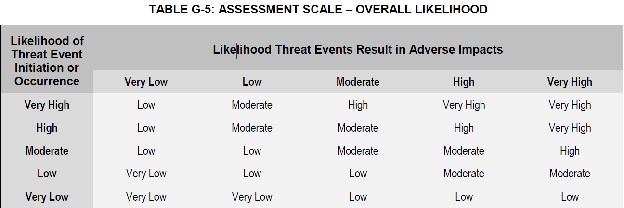
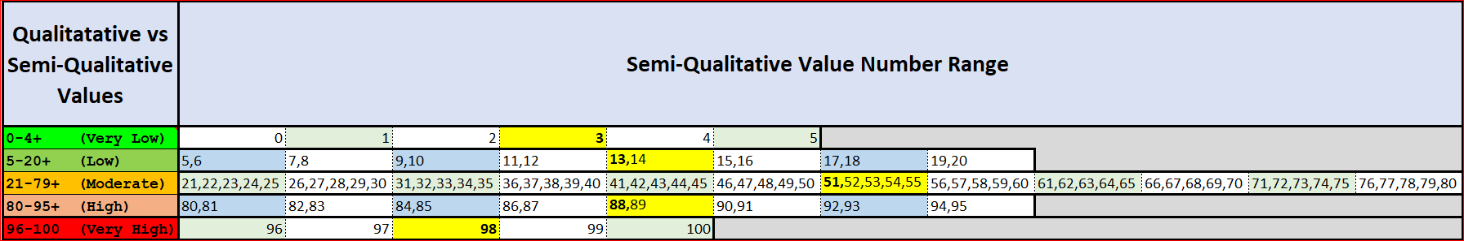
Calculated Cell Results Using Mean Values

Slide 3
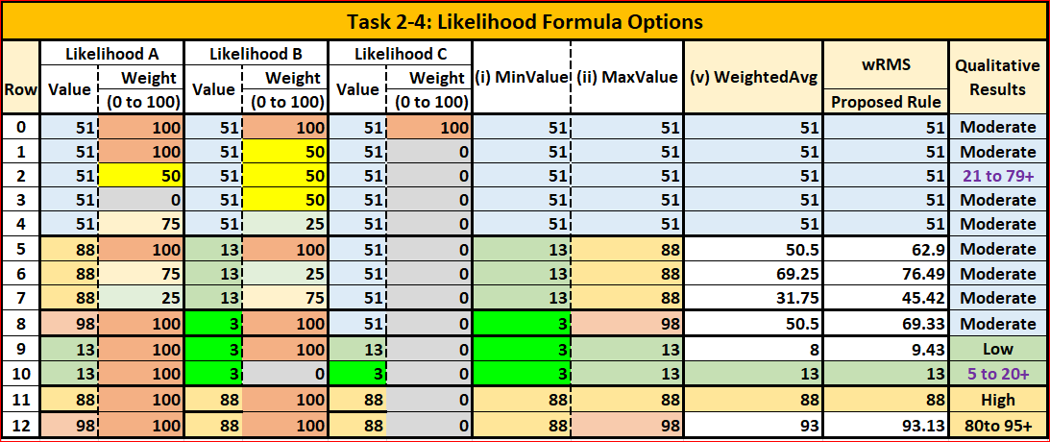
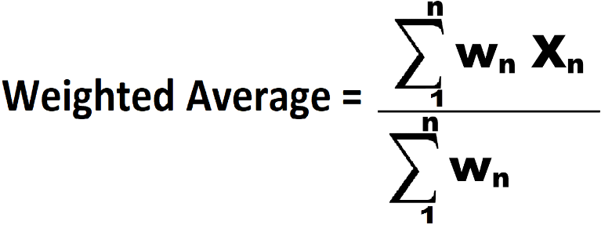
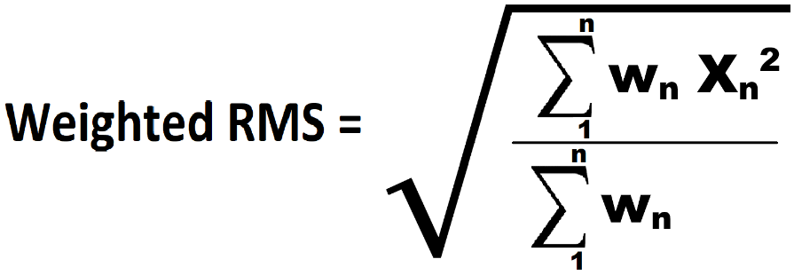
Task 2-4: Likelihood Formula Options

Slide 4
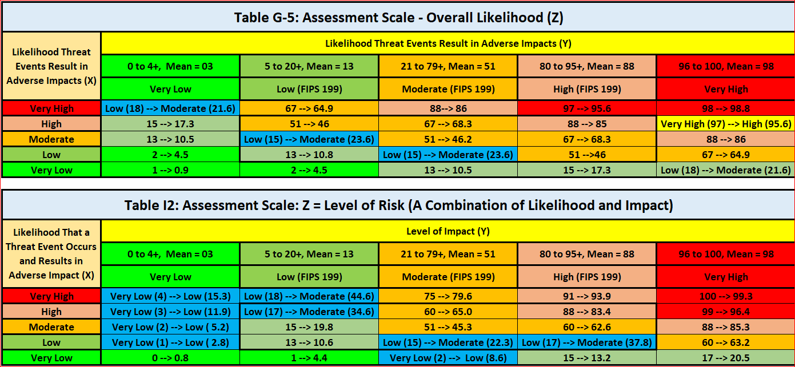
Calculate Cell Results vs Assessment Scale

Slide 5
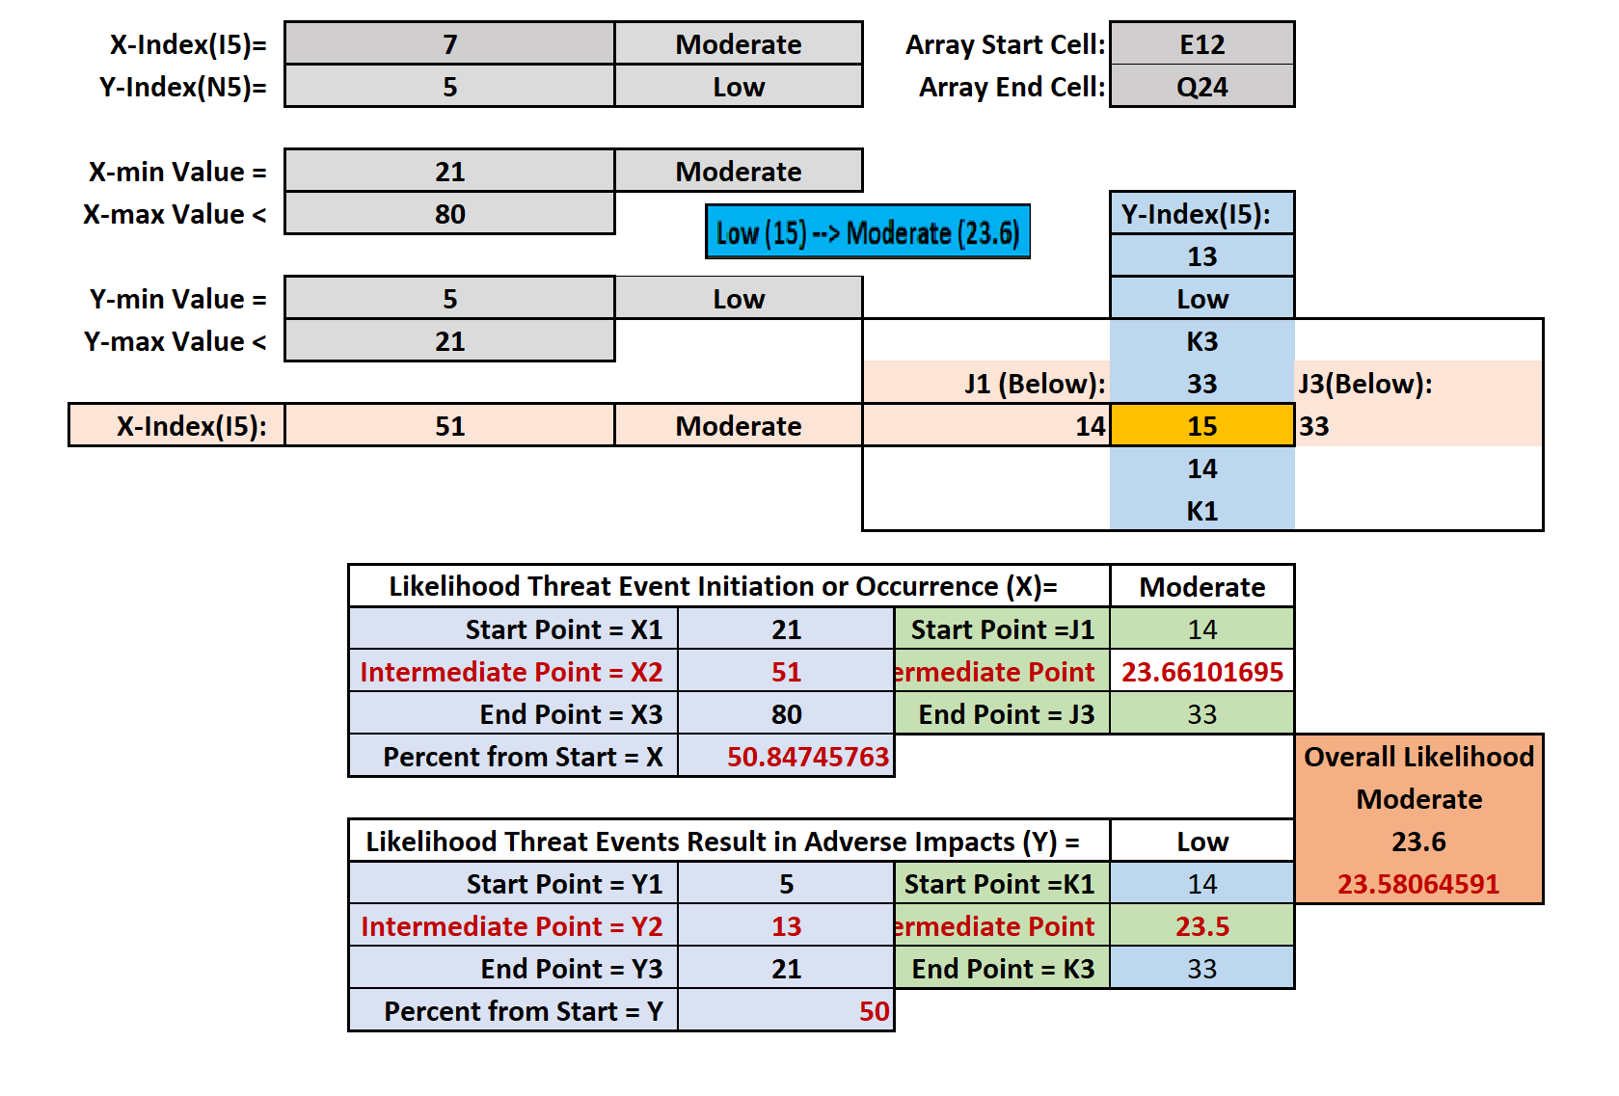
Extrapolating Likelihood Semi-Qualitative Value

Slide 6
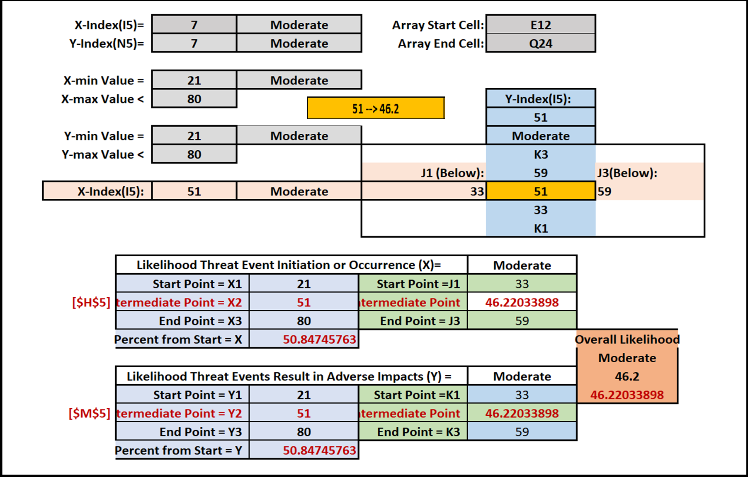

Slide 7
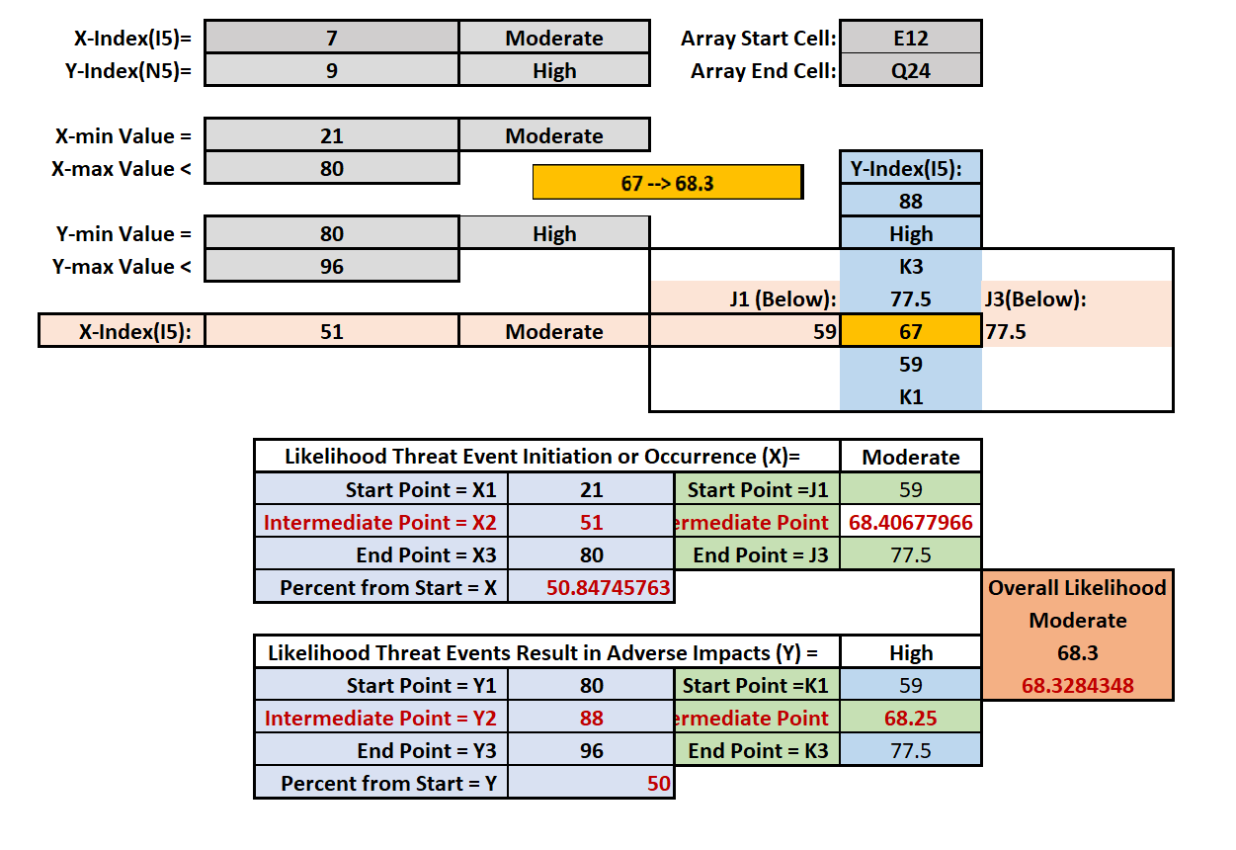
Extrapolating Likelihood Semi-Qualitative Value

Slide 8
Include?
NIST Special Publication 800-30 Revision 1
2.3.1 Risk Mode
Risk factors are characteristics used in risk models as inputs to determining levels of risk in risk assessments. Risk factors are also used extensively in risk communications to highlight what strongly affects the levels of risk in particular situations, circumstances, or contexts. Typical risk factors include threat, vulnerability, impact, likelihood, and predisposing condition.
A predisposing condition is a condition that exists within an organization, a mission or business process, enterprise architecture, information system, or environment of operation, which affects (i.e., increases or decreases) the likelihood that threat events, once initiated, result in adverse impacts to organizational operations and assets, individuals, other organizations, or the Nation.

